Slide 1

EZONE BUILDING ENERGY MANAGEMENT SYSTEM
https://youtu.be/dwABZ59RbKo
Jason Chu 21300674@student.uwa.edu.au
Lifsania Francis Xavier Robin 22873367@student.uwa.edu.au
Willem Meyer 21496322@student.uwa.edu.au
Yiwen Li 22061312@student.uwa.edu.au
Notes:
NOTE: Want a different image on this slide? Select the picture and delete it. Now click the Pictures icon in the placeholder to insert your own image.

Slide 2
Team members
21300674 Jason Chu
22873367 Lifsania Francis Xavier Robin
21496322 Willem Meyer
22061312 Yiwen Li
Project Sponsor :
Prof. Thomas Bräunl, EECE, M018 REVproject.com
The Univ. of Western Australia Robotics.ee.uwa.edu.au
35 Stirling Hwy, Perth 6009 +61 8 6488-1763 CRICOS 00126

Slide 3
Project title and brief description
EZONE BUILDING ENERGY MANAGEMENT SYSTEM
This project implements a building information system that collects data from various energy devices and then visualize the data in a public webpage.
4 Layers :
Data collection
Database management
Data Transformation
Presentation

Slide 4
Deliverables
The system - http://robotics.ee.uwa.edu.au/telemetry/ems/index.html
Source code - https://uniwa.sharepoint.com/:u:/r/teams/UWARoboticsAutomation-Energy/Shared%20Documents/Energy/EMS/SourceCode.zip
User Manual - https://uniwa.sharepoint.com/:w:/r/teams/UWARoboticsAutomation-Energy/Shared%20Documents/Energy/EMS/EMS%20User%20Manual%20v1.1.docx
Video presentation - https://uniwa.sharepoint.com/:v:/r/teams/UWARoboticsAutomation-Energy/Shared%20Documents/Energy/EMS/Presentation%20video

Slide 5
System Structure

Slide 6
System overview
The system with the database is hosted in Robotic server
When the Cron job executes in Bluehost server, the data collector php is refreshed
The data collector php read data from the energy device APIs and insert data into database API table
When the database API table has a new record, the table trigger will convert inserted raw records to transactions according to the configurations
The transform layer will read the data from the database output API when the transform layer is triggered by the presentation layer
The transform layer will output JSON format data to presentation layer
The presentation layer visualize the data on the web page to the users

Slide 7
Detailed system structure

Slide 8
System structure decisions
The key decision is to use Robotic server to host the system because the Ezone Revata APIs can be only accessed inside UWA network.
The Data Collector php will retrieve the energy data from APIs and save into the database when the Data collector php is triggered to refresh.
Bluehost server Cron job is set up to trigger the Data Collector php every 5 minutes, because the project team does not have permission to execute Cron job in the Robotic server.
The transform layer will fetch the data from the database and provide a jason format out to the presentation layer.
If the database does not have data for the last 30 minutes, the transform layer will trigger the data collector php again to read the latest data from the APIs.
The presentation layer will trigger the transform layer when the users operate on the web page

Slide 9
Data collector

Slide 10
Data Collection
Connection of pre-existing data APIs to the new Management system Database
API > SQL Queries > Database (transaction_table_ext)
Designed with horizontal scalability in mind
Open to expansion with ease
EZONE and the REV Projects DC Charging service
Current implementation
2 php files for EZONE and DC Charging
Design Decisions and changes of scope
Expandability and prototype changes

Slide 11
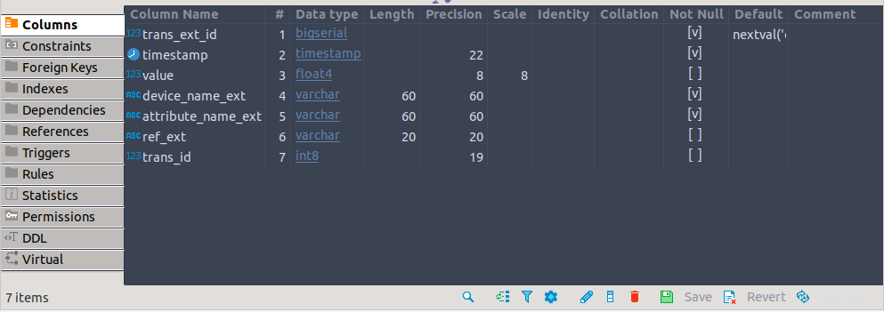
External Transaction table
ems_transaction_ext_table
Notes:
Prior to transformation and visualisation of the data – the data must be sorted into the external table – Specifically shaped to fit four required columns, must fill this information to be accurately visualised
TIMESTAMP, VALUE, DEVICE NAME, ATTRIBUTE NAME – two of which need to be premapped

Slide 12
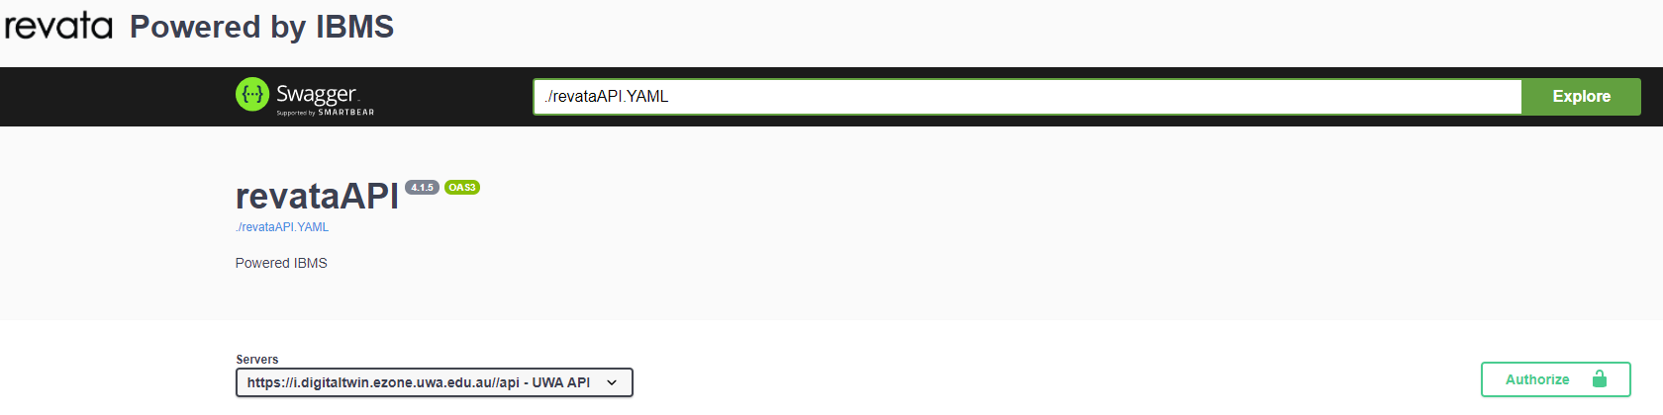
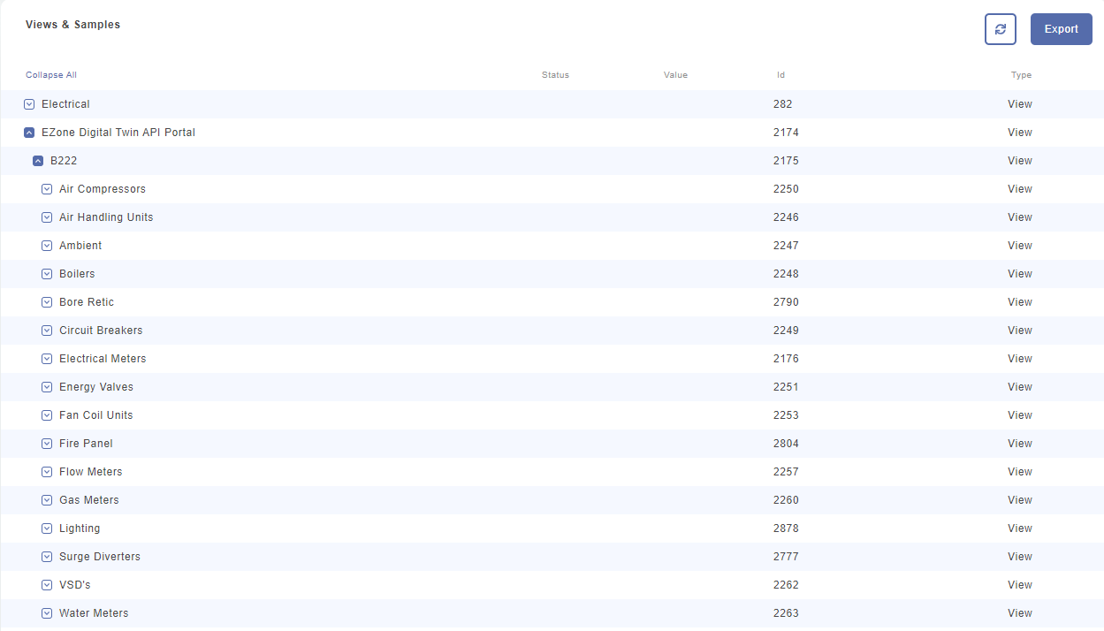
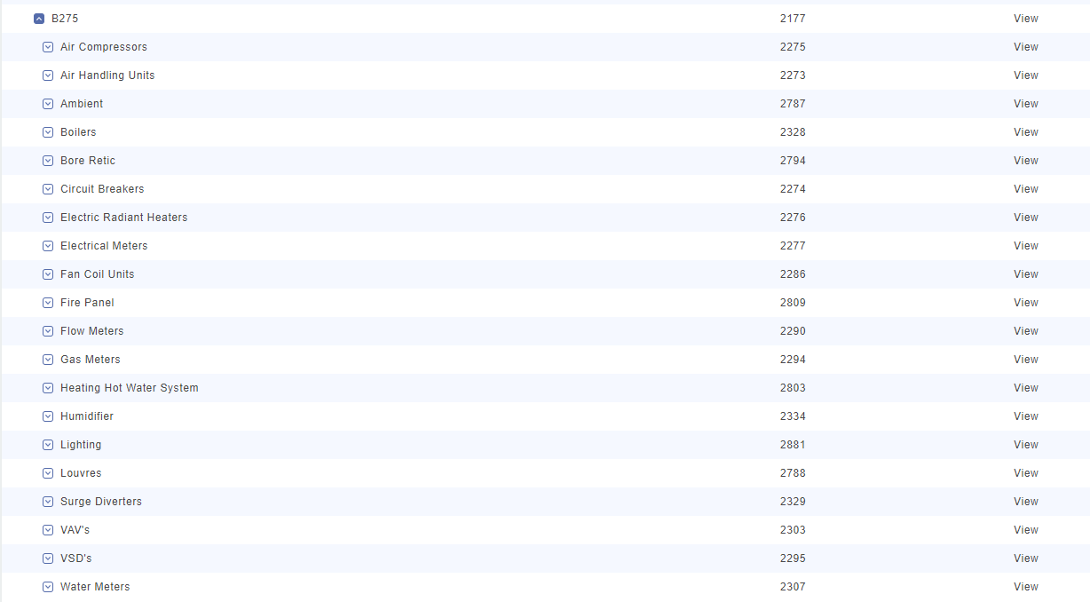
EZONE Building

Slide 13
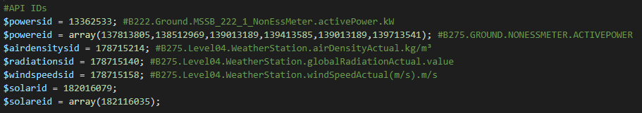
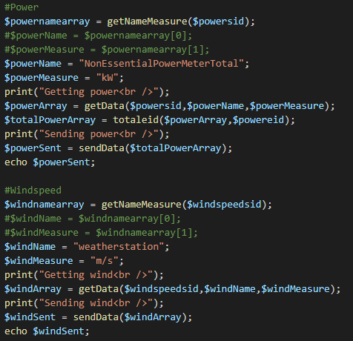
EZONE Building
getEzone.php
Call the API from 2 hours -> now
Get name & unit of measurement of device
Call /revata.API/get_trendable_data
Total multiple devices if required
Send data to database with SQL Queries
Avoids duplicates

Slide 14
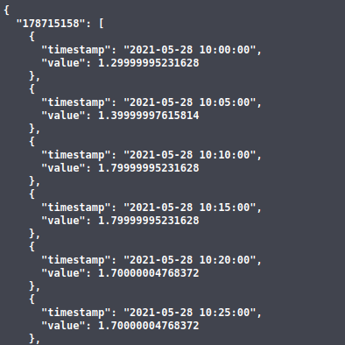
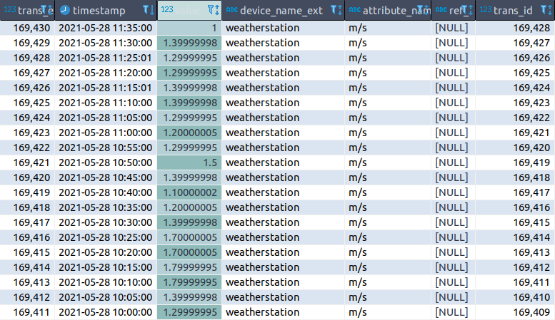

EZONE Building

Slide 15
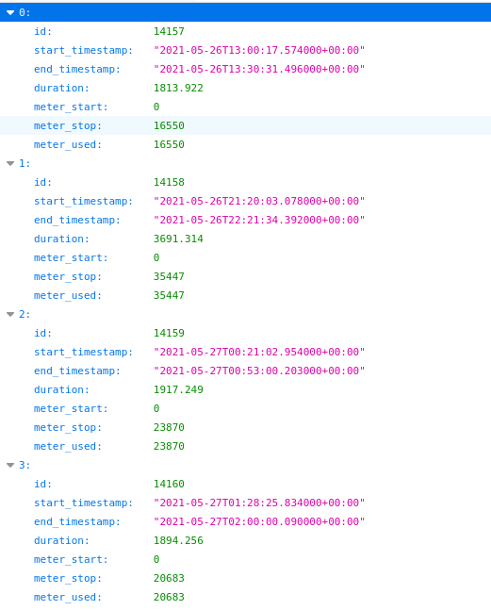
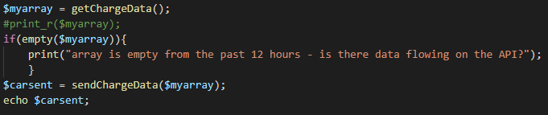
DC Car Charging API
getCharging.php
Call API, 12 hours to now (API problem)
Get all charging times – divide into 5 mins
Allocate % of charging time per 5 minutes
INSERT INTO ems_transaction_ext_table

Slide 16
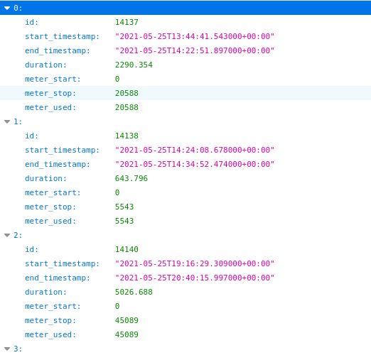
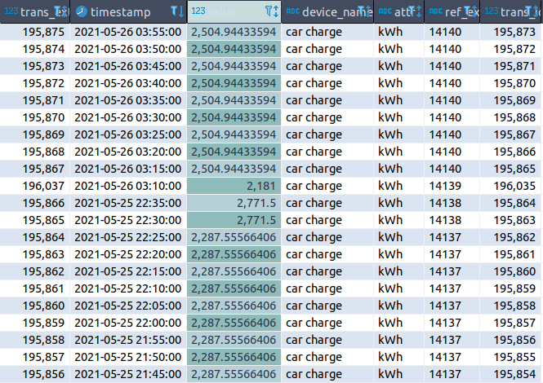
DC Car Charging API

Slide 17
Scope and Source Device Changes
Scope of sources originally planned:
EZONE API
DC Car Charging Stations API
Human Movement Building .xml
Future Farm .xml
Current Scope of sources in current implementation
EZONE API
DC Car Charging Stations API
Human Movement Building .xml
Future Farm .xml
+ Feature adding new data sources

Slide 18
Database design

Slide 19
Database overview
Raw data received at the input API table from Energy data collector
Treated data provided at output API view to Web pages
To visualize data flows, the database has been structured into four layers:
input layer
configuration layer
transaction layer
output layer

Slide 20
Detailed database design

Slide 21
Database design decisions
The key design principle of the database to make the data structure of Energy Management system to be flexible and extensible.
The input layer is designed as an API to receive the raw device data from Data collector.
The configuration layer is introduced to manage the dimensions of the energy data.
The transaction layer includes a table to store all the treaded and reduced transactional data of the system.
The output layer is designed to be output interface with a view.

Slide 22
Transform layer

Slide 23
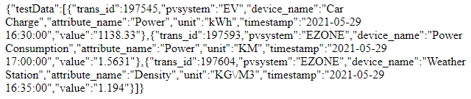
Transformation Layer overview
Data from the database should be transformed to be presented on to the front-end
The result of the sql queries were converted to JSON format

Slide 24
Tasks
Initial one month load – Since there is a huge number of records, we load the data only once
Latest record every five minutes – The latest record is auto fetched to save memory
Configuration Page – Admin level access to modify devices/attributes

Slide 25
Configuration Page
The admin user can add a new or delete an existing device/attribute or update an existing device/attribute by specifying the action required along with the new or old device/attribute name in which the change is to be made. This change is then updated the in the database.
The admin can now also modify the device or attribute mapping table with the device or attribute names after which the change would be reflected on their respective tables in the database.
The admin should also be able to view and modify the combination table which shows how each attribute and device systems are related to each other.

Slide 26
Presentation layer

